Slide 1

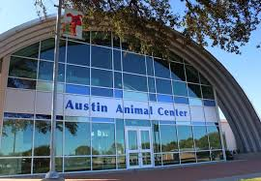
PREDICTING ANIMAL OUTCOMES
Travis Lemon & John Bonfardeci
ISTM 601 Team Project

Slide 2
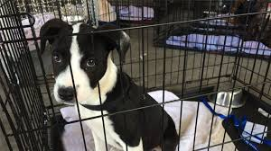
Objective
Improve and/or better understand the outcomes for sheltered animals in the Austin Animal Center. Further, we aim to predict the outcome for each animal (adopted or not adopted).
This information could help the shelter better understand trends in animal outcomes and create effective plans of action.

Slide 3
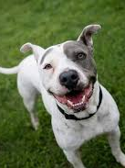
Problems and Challenges
Missing Values (minimal)
Amount and inconsistency of Breed and Color variables
Lack of a binary target variable (i.e. 1 and 0) indicating adopted or not adopted
Original column groups were not conducive for accurately predicting animal outcomes

Slide 4
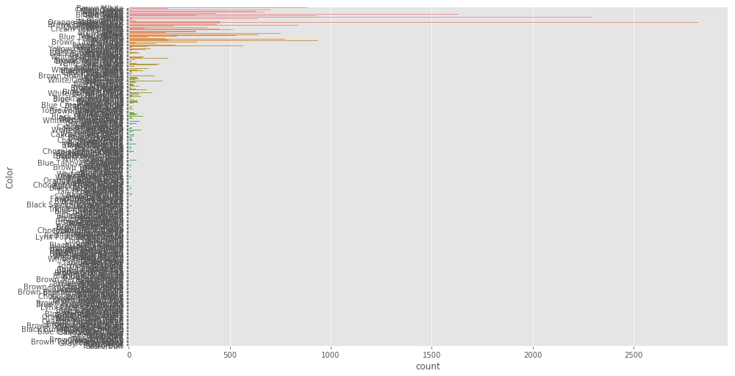
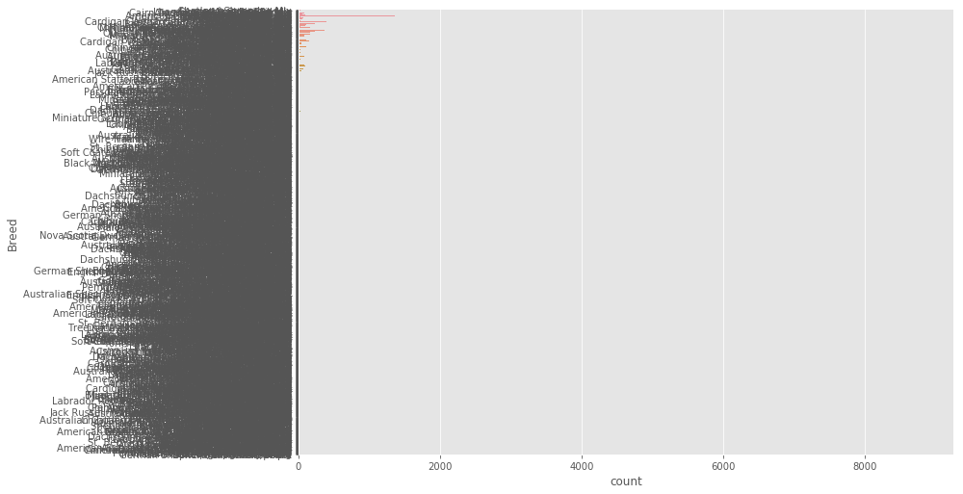
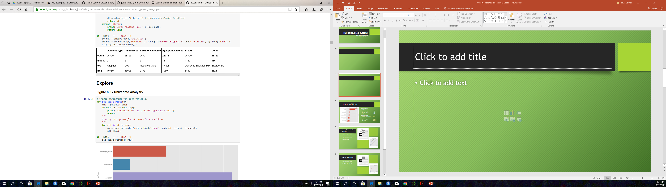
Sample Raw Data - Univariate Analysis

Slide 5
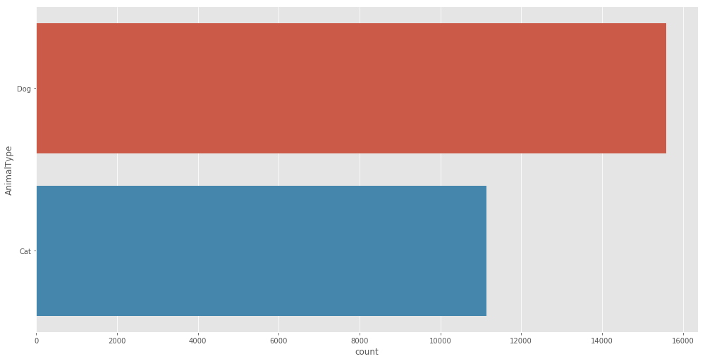
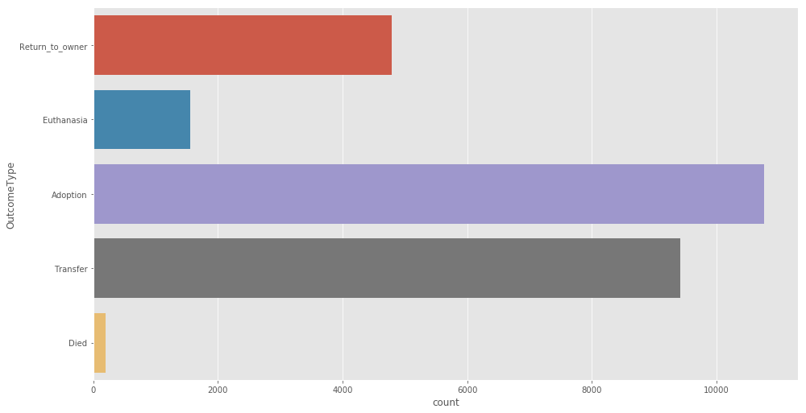
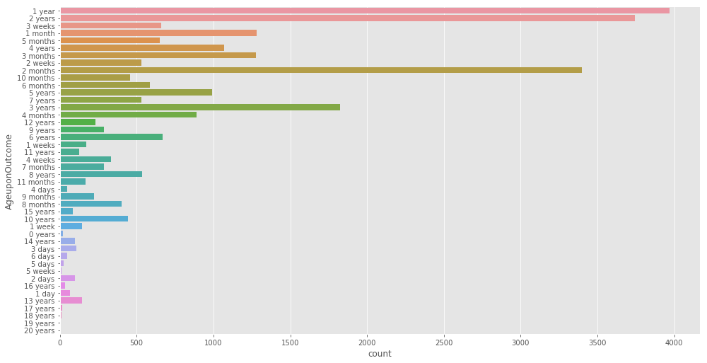
Sample Raw Data - Univariate Analysis

Slide 6
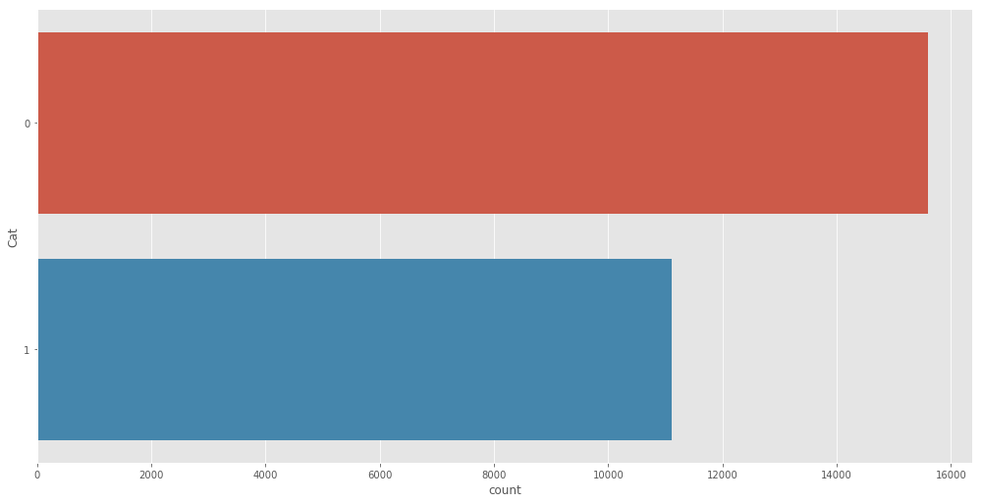
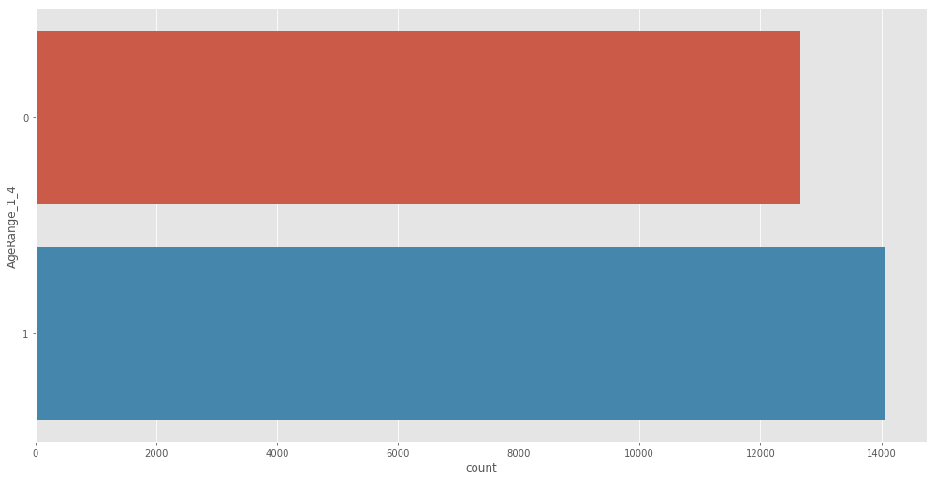
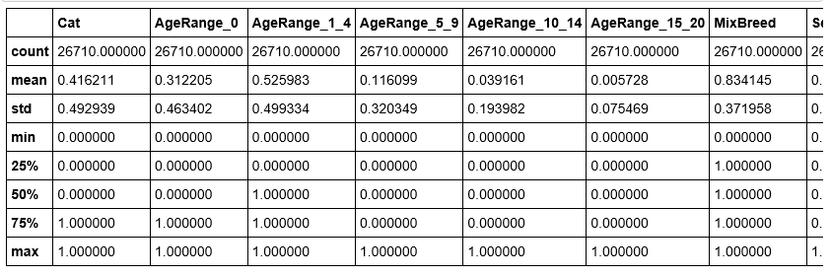
Dataset Transformation

Slide 7
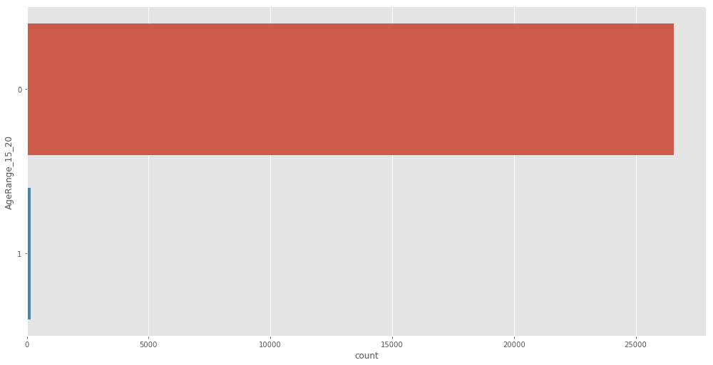
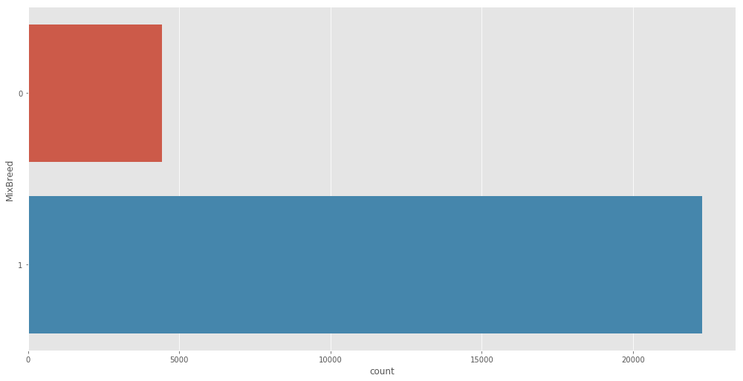
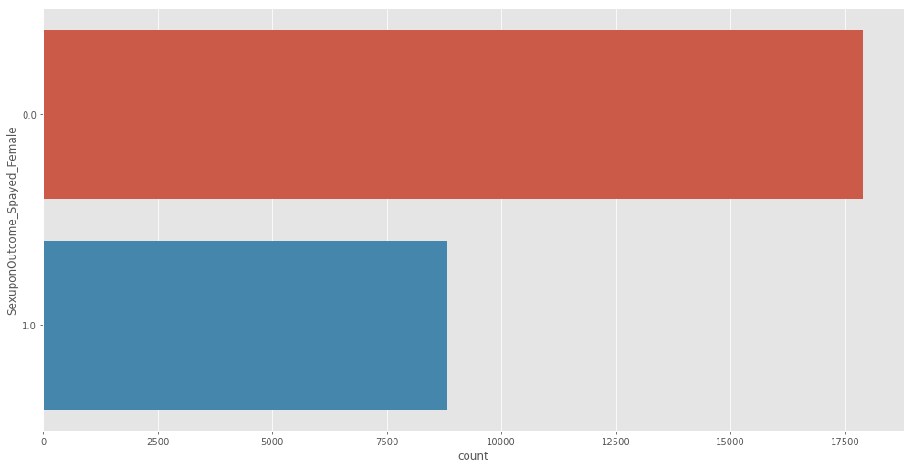
Dataset Transformation

Slide 8
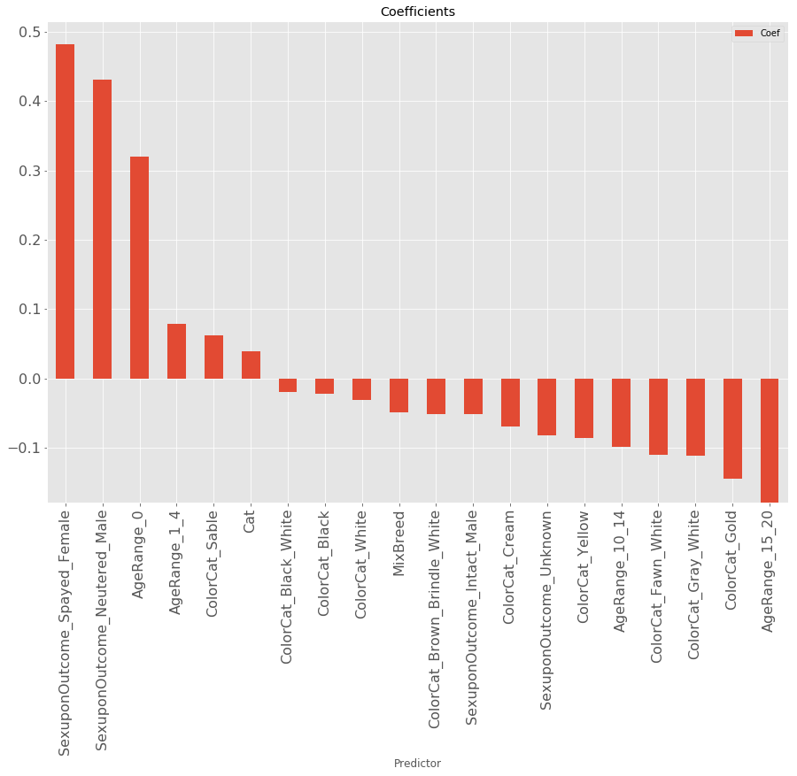
Predictor Coefficients
Positive Influence:
Spayed Female: 0.4882
Neutered Male: 0.4315
Age Range 0: 0.3205
Age Range 1 – 4: 0.0780
Color Cat – Stable: 0.0626
Cat: 0.0396
Negative Influence:
Color Cat – Black/White: -0.0197
Color Cat - Black: -0.0225
Intact Male: -0.0518
Age Range 10 -14: -0.0991
Age Range 15 - 20: -0.1790
Mix Breed: -0.0493

Slide 9
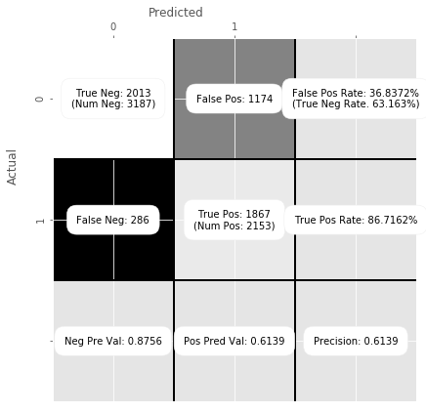
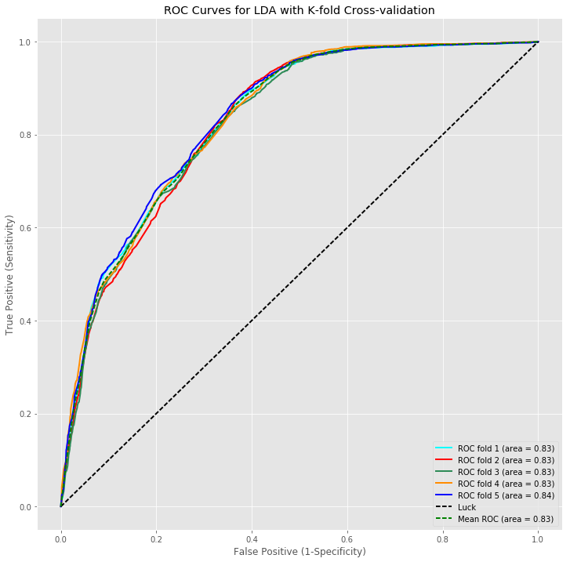
Linear Discriminate Analysis
False Positive Rate = 36.84%
True Positive Rate = 86.72%
Precision = 0.6139

Slide 10

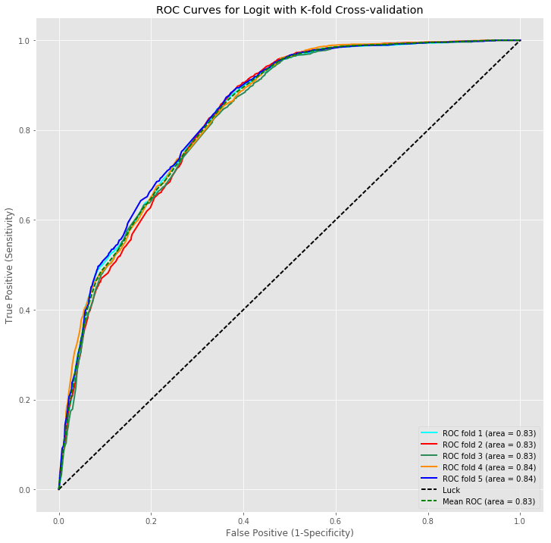
Logistic Regression
False Positive Rate = 36.22%
True Positive Rate = 88.24%
Precision = 0.6198

Slide 11
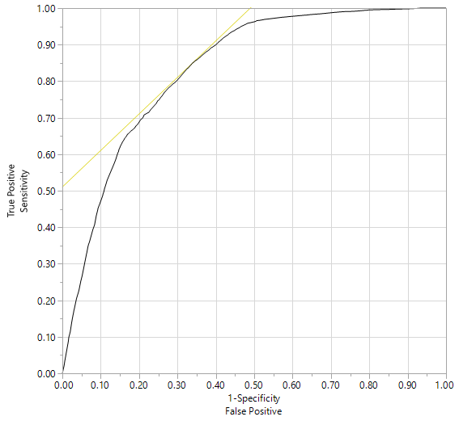
JMP Model
Sensitivity = TP / (TP + FN) = 7228 / (7228 + 2992) = 70.72%
Specificity = TN / (TN + FP) = 12968 / (12968 + 3541) = 78.55%
Precision = TP / (TP + FP) = 7228 / (7228 + 3541) = 67.12%

Slide 12
Interpretation and Conclusions
Logistic regression model outperforms LDA w/ a true positive prediction rate of 88.24%
Python logistic regression model also outperforms like-for-like JMP model
Advantages w/ Python models are the ability to utilize 5-fold cross validation to split the training data into 80/20, train/validate sets to obtain a more realistic mean TPR and TNR.
Interpretation based on our Python models are that people prefer cats. They prefer animals that have been spayed or neutered and are relatively new born, between the age range of 0 – 1 year old. It appears that most of the colors had a slightly negative impact. Also, what is clear by this analysis is that people do not prefer mixed breeds or animals greater than 10yrs old.

